Slide 1

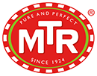
MTR Foods Pvt. Ltd.
Notes:
Links:
https://www.pexels.com/photo/five-bulb-lights-1036936/
https://www.free-power-point-templates.com/

Slide 2
Project By:-
Team Leader – Nambala Hemalatha
Team members – J.Harika
G.Mohini
G.Kavya
I.Vivek patrudu
Notes:
Links:
https://www.pexels.com/photo/five-bulb-lights-1036936/
https://www.free-power-point-templates.com/

Slide 3

ABOUT THE COMPANY
A tradition that began in 1924 has transformed into an illustrious venture today. A business that brings quality and authenticity in cuisine. An enterprise that blends entrepreneurship with originality. This is the rich legacy of MTR.
Notes:
Links:
https://www.pexels.com/photo/apple-devices-books-business-coffee-572056/

Slide 4
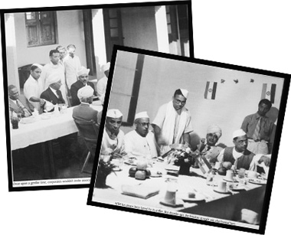
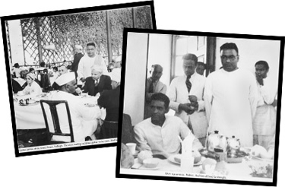
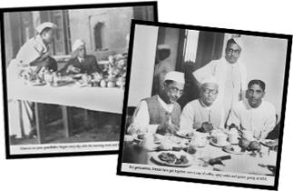
MTR’s wide range of products include ready-to-eat curries and rice, ready-to-eat cook gravies, frozen food, ice-cream, instant mixes, spices and variety of pickles & papads, and milk beverage drinks. MTR has its footprints across the globe. To fuel further growth, MTR became part of Norwegian Company M/s Orkla in 2007. For further details regarding Orkla, log on to www.orkla.com.
Culinary secrets have been protected and handed down over the generations and our food is based on truly authentic recipes from their region of origin. Our journey to India’s premier, processed food company has been marked by innovation and the adoption of new technology. Precisely, every MTR product will always embody our tradition of unmatched taste, purity and quality.
HISTORY
Our tradition of food and hospitality began in 1924 with the establishment of the MTR Restaurant by the Maiya family in Bangalore. This restaurant is a city landmark today and people still stand in queue to savour its unique, completely authentic dishes. Then in 1975, Maiyas diversified into the business of convenience foods and instant mixes. As the business expanded, modernization and state-of-art facilities, including dedicated Lab and printing and packaging facilities, were added.
Notes:
Links:
https://www.pexels.com/photo/group-of-people-watching-on-laptop-1595385/
https://www.pexels.com/photo/man-wearing-white-long-sleeved-shirt-holding-black-pen-3182781/
https://www.pexels.com/photo/group-of-people-in-conference-room-1181304/

Slide 5

VISION
MISSION
To Provide ‘Authentic Indian Vegetarian Food Experience’ to the consumers across the World'
Your friend in everyday life
VALUES
Brave
Trustworthy
Inspiring
We continuously challenge ourselves to be Brave – to think more innovatively, to act more boldly, to be world-class. We as Brave people have aimed high and loved to win. We speak up if something is wrong.
We demonstrate that we are Trustworthy people, who are professional, skilful and reliable. People can trust us. We keep our promises. We deliver.
We inspire. We are passionate and burn with a desire to succeed. We innovate continuously. We Inspire consumers, customers, partners and each other.
Notes:
Links:
https://www.pexels.com/photo/photo-of-people-looking-on-tablet-3182835/

Slide 6
TAGLINE
MTR: PURE AND PERFECT SINCE 1924
A tradition that began in 1924 has transformed into an illustrious venture today. A business that brings quality and authenticity in cuisine. An enterprise that blends entrepreneurship with originality. This is the rich legacy of MTR.
Notes:
Links:
https://www.pexels.com/photo/apple-devices-books-business-coffee-572056/

Slide 7
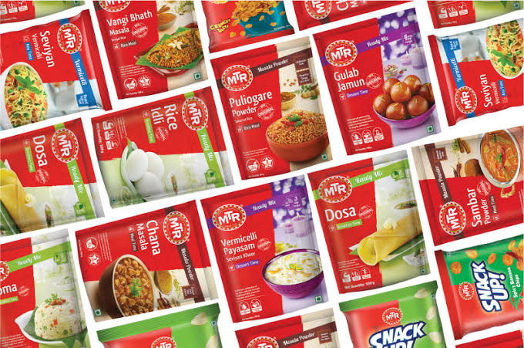
1. Ready to Eat
Breakfast Mixes
Snack Mixes
Ready to Eat Meals/Curries
2. Spices & Masala
PRODUCTS
Spices
Meal Mixes
Blended Masalas
Chutney Powders
There are Wide range of products which offer complete meal solutions for all time of the day
3. Sweets & Desserts
Ready to Eat Sweets
Dessert Mixes
4. Beverages
Badam drink cans
Drink Mixes
5. Vermicelli, Pasta, Pickles & Other products
Notes:
Links:
https://www.pexels.com/photo/apple-computer-computers-desk-326504/

Slide 8
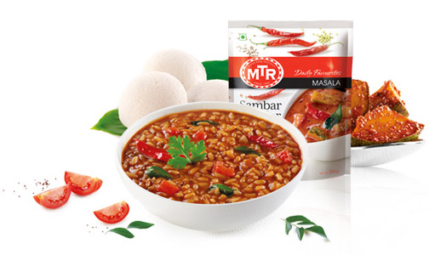
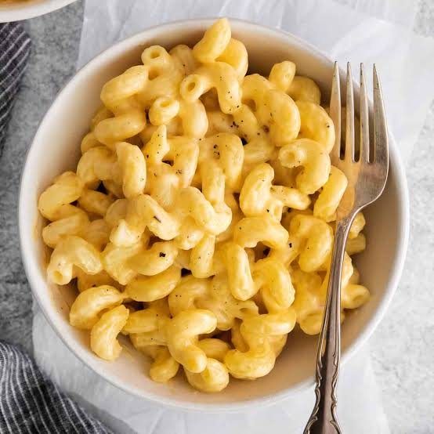
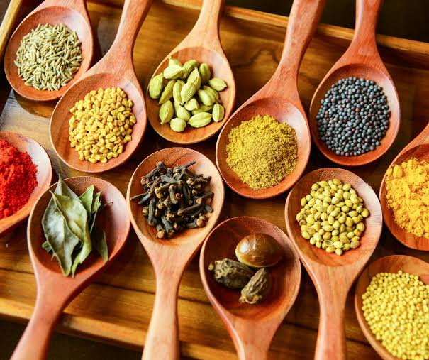
USP
Taste the journey of lifetime
At MTR Foods, we take pride in our rich heritage of over 85 years. We believe our journey mirrors that of our nation; a legacy forged by generations together. Right from our traditional beginnings to the 21st century technological prowess, our offerings are part of a rich Indian heritage.
With the finest ingredients, it is no wonder that we believe in adhering to our authentic recipes.
Believe in being future-forward and matching the pace of technology to reach our fast-moving consumers
.place immense emphasis on our employee safety and health policy to produce optimum results.
With our certified food and safety policy, we not only believe but also ensure that quality stands first.
Notes:
Links:
https://www.pexels.com/photo/group-of-people-watching-on-laptop-1595385/
https://www.pexels.com/photo/man-wearing-white-long-sleeved-shirt-holding-black-pen-3182781/
https://www.pexels.com/photo/group-of-people-in-conference-room-1181304/

Slide 9
Brand Message
MTR Foods has unveiled their latest campaign to celebrate the women who add to their promise of authenticity. The campaign #HandsOfAuthenticity pays tribute to women of Byadagi, a small town in Haveri district of Karnataka. MTR and Wavemaker co-created the concept and Wavemaker films, the production unit of Wavemaker India, conceived and executed the campaign.
#HandsofAuthencity aims to share the untold story of Byadagi women who are extremely passionate, dedicated and proud of their work. The film captures the story of the origin of this spice, the hardships faced by these women and journey of this spice from their farms to our homes.
Sunay Bhasin, chief marketing officer, MTR Foods, said, “MTR stands for great quality and authentic taste. Story of Byadagi captures the passion and pride with which the women have been contributing to MTR’s promise of authenticity for generations. We found a great partner in Wavemaker and they helped us bring this story to life beautifully.”
Karthik Nagarajan, chief content officer, Wavemaker India, said, “Through this campaign, we wanted to showcase the real heroes who bring the best of these spices to us despite the hardships they experience in their daily lives. MTR is a legendary heritage Indian brand and known for its authentic products. The film depicts the story of Indian culture which is strongly rooted in its origin.”
Notes:
Links:
https://www.pexels.com/photo/apple-computer-computers-desk-326504/

Slide 10
Indian consumers are still not completely ready for instant food products usage.The still prefer freshly cooked home food than processed and packaged food. There are only few brands in this category which are available like MTR, ITC’skitchens of India etc. MTR is the most preferred brand as it is a home brand of Bangalore and has a rich heritage. MTR does not spend much on their promotional activities, very rarely yousee their advertisements are aired but still it enjoys high brand awareness amongthe consumers. This is due to the good word of mouth publicity from a largenumber of satisfied customers. MTR has a good networking and distribution system. The products are availablefrom supermarkets to next to door kirana shops. They are supplied to the stores ona weekly basis to ensure the product freshness and quality
The products is not upto the mark in case of North Indian dishes and soups. The foodhas taste of chemicals present in it. Due to the potential growth opportunities in theinstant food segment, many big plays are entering. This may affect the monopolistic position of MTR. Hence MTR should work on their promotional strategies. They shouldadd news markets globally and make MTR a global brand. More innovation needs to be brought nto the products and packaging needs to be made more attractive.
MTR is a strong brand and is bound to become an global brand due to its relationshipwith large number of loyal customers all across the globa
CONSUMER BEHAVIOUR
Notes:
Links:
https://www.pexels.com/photo/apple-computer-computers-desk-326504/

Slide 11
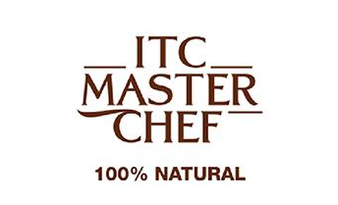
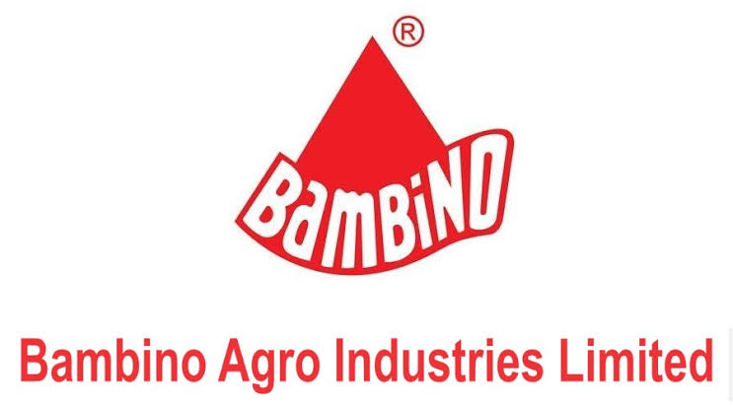
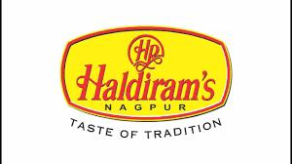
Competitor Analysis
The following are the Major Competitors of MTR Foods Pvt. Ltd.:-
TC has crafted its range to help change this perception by providing a number of nutritious, preservative-free and delicious choices, using advanced individual quick frozen technology, which can be cooked in multiple ways, including baking, pan fry, tawa fry, shallow fry, air fry and of course even deep fry as the consumer may like it
Durum wheat semolina
0% maida
Untouched by hand – Made with European tech
Bambino vermicelli has 2% more protein compared to other brands owing to its high-quality wheat
Fortified with vitamins and minerals
Quality, Taste, Local culture, Hygiene
Packaging, Good shelf life
Innovative Products
More Loyal Customers
Strong brand value
Wide Customer base
Notes:
Links:
https://www.pexels.com/photo/woman-draw-a-light-bulb-in-white-board-3758105/
https://www.pexels.com/photo/working-in-a-group-6224/
https://www.pexels.com/photo/person-s-holds-brown-gift-box-842876/

Slide 12
MARKETING STRATEGY
Authenticity is one of the main aspects which are mandatorily maintained in all the products manufactured so far in all the packaged food products made by MTR. So, the main market strategy is to deliver the consumers with the instant food products having the exact aroma and flavor.
As the company has the history of a high standard eatery, all the products are made with premium quality ingredients. The hygienic atmosphere is maintained in case of making the products. The past of having the standardized eatery makes the brand still credible to the public.
Expansion of the domestic presence of MTR is one of the greatest marketing strategies taken by the brand. Presently there are outlets of the company in most parts of the country.
MTR exports the products in different countries like United States, United Kingdom, Middle- East, Japan, Canada, Australia, Singapore, Malaysia and Mauritius.
Apart from the export market, there are MTR super shops which are situated in the different states of India.
Notes:
Links:
https://www.pexels.com/photo/apple-computer-computers-desk-326504/

Slide 13
MARKETING STRATEGY
(Contd.)
MTR, originating in Bangalore, could understand the need of the packed food among the public properly. They implemented the 4Ps successfully in each product. These Ps comprises of Product, Place, Price and Promotion.
.The total worth of the MTR Company is 700Crore.The CAGR growth percentage is 18%. Most of the sales generally happen in the states of the southern India. One of the main reasons for which MTR has got so much of market excellence is due to the nominal costs. People from all strata can easily afford the food mixes from MTR.
The web portal of MTR enhances the profit for the company as the distribution costs dramatically decreases. Moreover, the incentive of 20% extra product helps to enhance to the market position and the sales from the company.
MTR, at present have come forward with the desperate marketing strategy to sustain in the reputed position it has earned in all these years.
Sampling is one of the major aspects on which the company has put its eye into. In most of the cities, the sampling activity has taken place. All Medias are used by the company to put up the various a advertising campaigns.
Notes:
Links:
https://www.pexels.com/photo/apple-computer-computers-desk-326504/

Slide 14
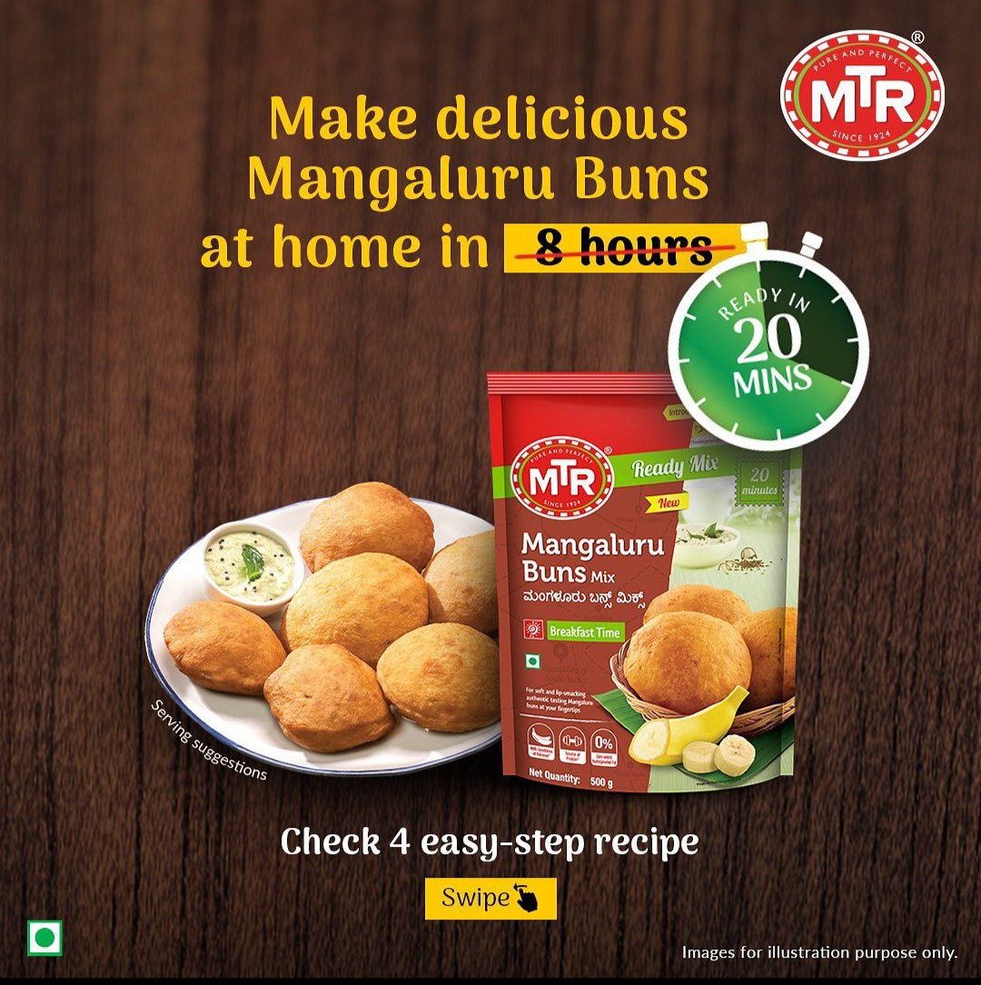
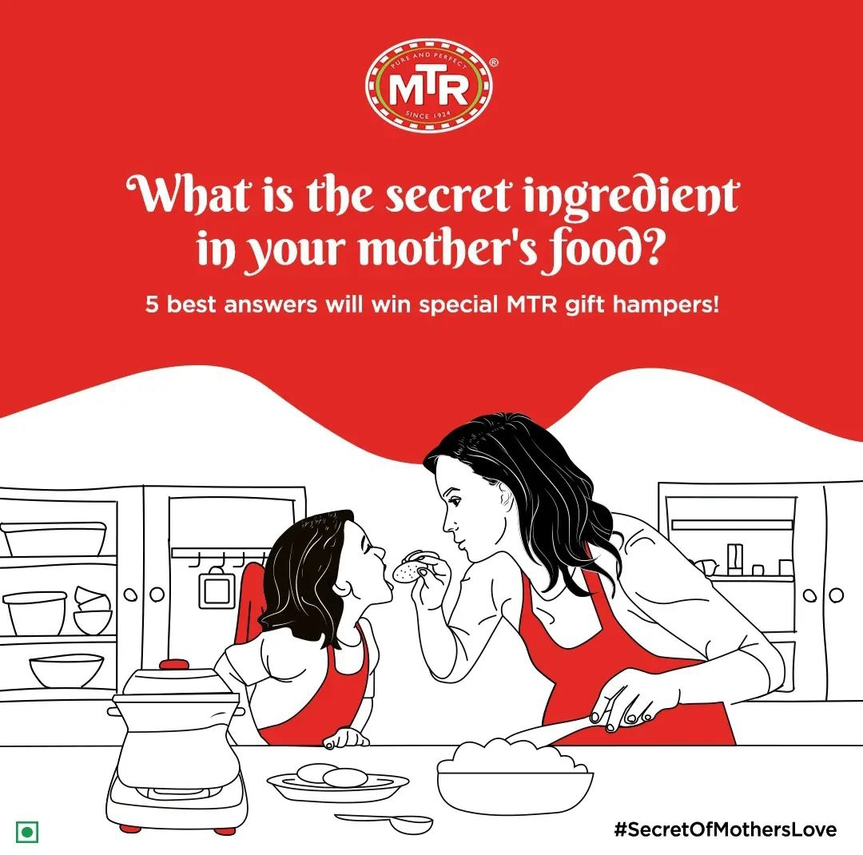
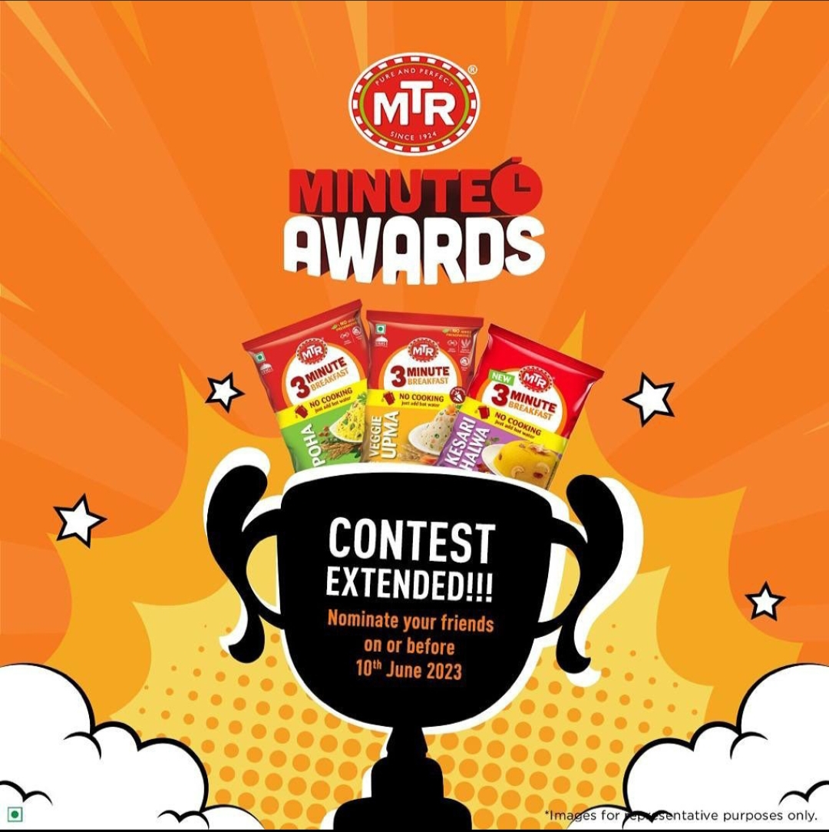
Digital Marketing Campign
A high level of safety measures including thermal checking is in place to check the workers and staff before they enter the premises every day. Each staff member is also provided with protective gears like masks, shoe-covers and aprons to use while working in the factory along with hand sanitizers that are available at all accessible points. Every corner of the facility including the doorknobs, handles and railings are cleaned intensively every two hours and the buses that bring in the workforce are sanitized as frequently as possible. Even at the point of delivery, the organization has put together strict measures to ensure the safe delivery of MTR products to the consumers
MTR Foods Pvt. Ltd., the pioneer of packaged food products in India have always believed in putting their consumers first and that continues to be their motto even now. To showcase the safety standards followed while manufacturing and delivering the products, MTR Foods launched a digital film that aims at providing consumers across the country with a sense of reassurance.
The film focuses on the safety measures that MTR Foods is following during production and distribution. To maintain MTR Foods products’ high quality while following safety norms of sanitization and social distancing and ensure that the supply of MTR products does not get impacted, the front-line sales staff and production workers continue to work tirelessly
Notes:
Links:
https://www.pexels.com/photo/group-of-people-watching-on-laptop-1595385/
https://www.pexels.com/photo/man-wearing-white-long-sleeved-shirt-holding-black-pen-3182781/
https://www.pexels.com/photo/group-of-people-in-conference-room-1181304/

Slide 15
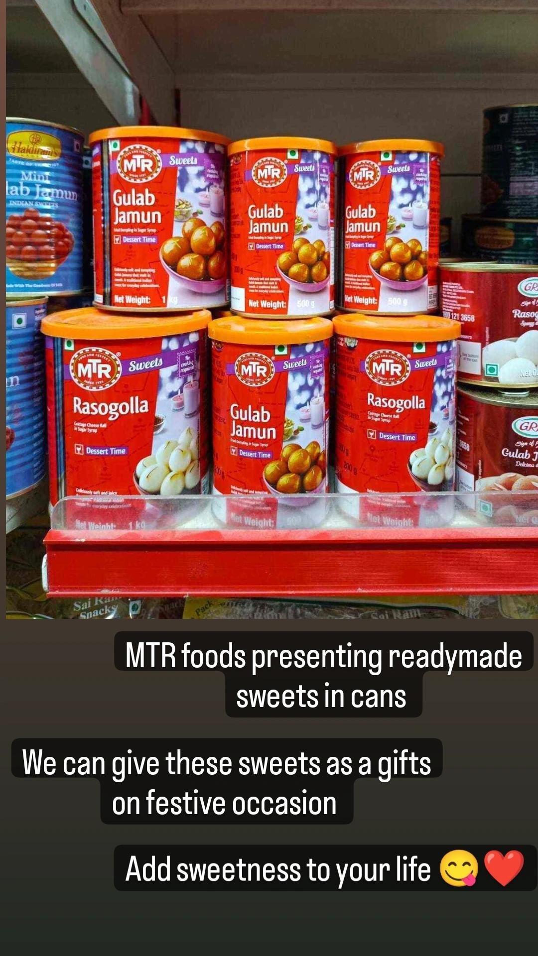
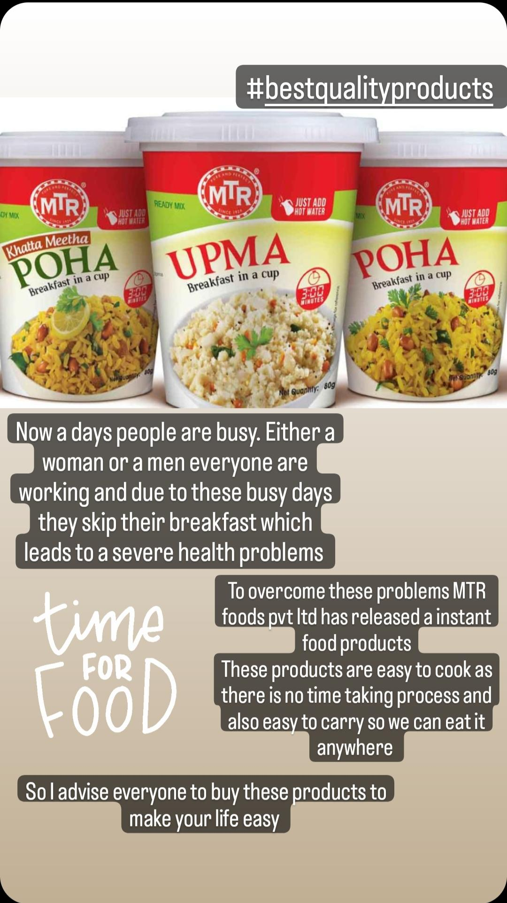
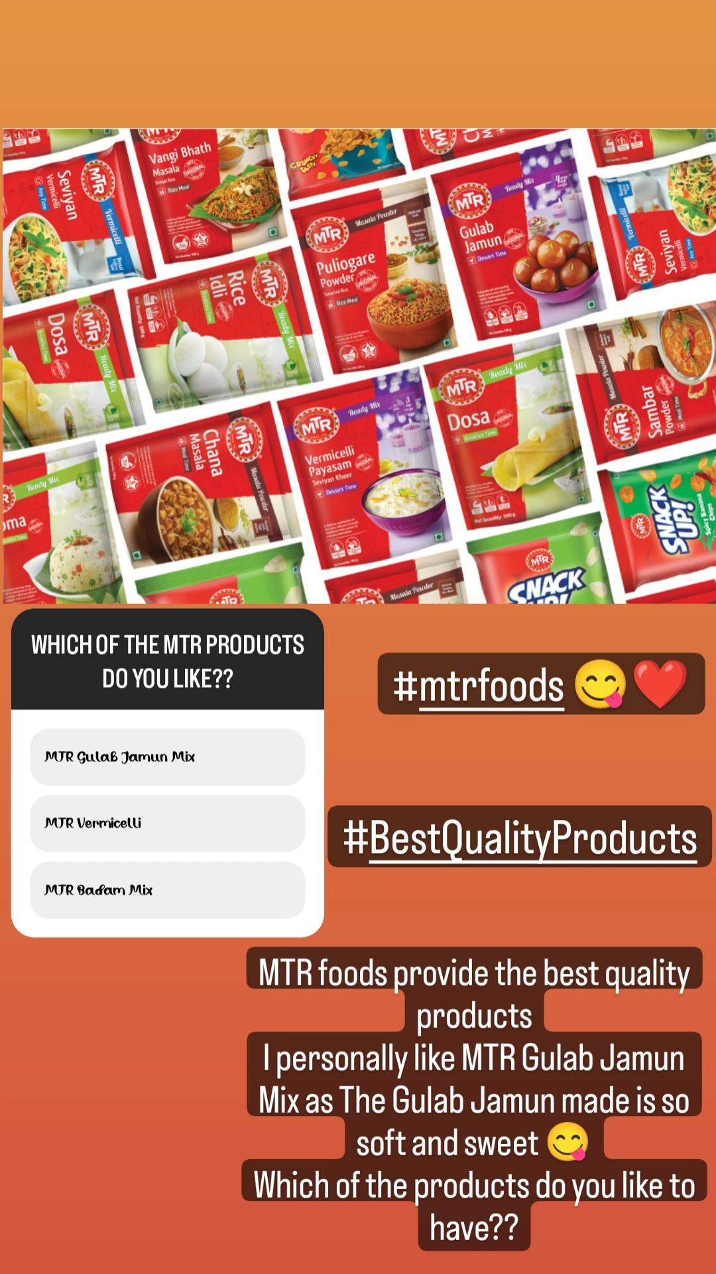

Slide 16
Brand awareness
MTR brand has a rich legacy of nearly 90 years in the Indian packaged food space, focusing on spices and ready-to-cook/ready-to-eat meals. It was a much loved and revered brand which stood for authenticity and high adherence to quality. Over the years, the target segment of the brand evolved. The new Indian woman went from being a ‘passive supporter’ of the family to a ‘discerning homemake’. She aspired for newness and modernity while guarding authentic cuisines and traditions. MTR wanted to associate itself with this ‘new evolved’ homemaker. While retaining the brand’s authentic core was essential, it was also important to represent the brand as one in tune with evolving tastes. The marketing team needed to figure out what the new brand identity of MTR should be.

Slide 17
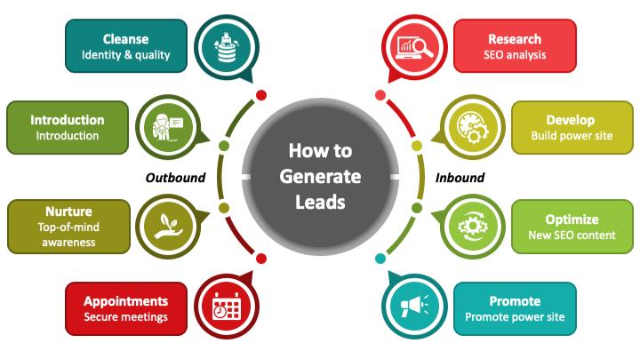
LEAD GENERATION
In the world of digital marketing service, lead generation company can serve as your first step to get closer to the customer, based on the interest or inquiry of the products/services shown by them
Leads generation, being the first step in bringing customers to the company, is why it is paid great attention. The team helps in generating leads for the company to get more customers and the CRM team will convert those leads into customers.
The campaigns used for generating leads are conceptualised by our team who implements them to gain validated leads.The qualified leads are then delivered to the clients or their marketing/sales manager through emails.

Slide 18
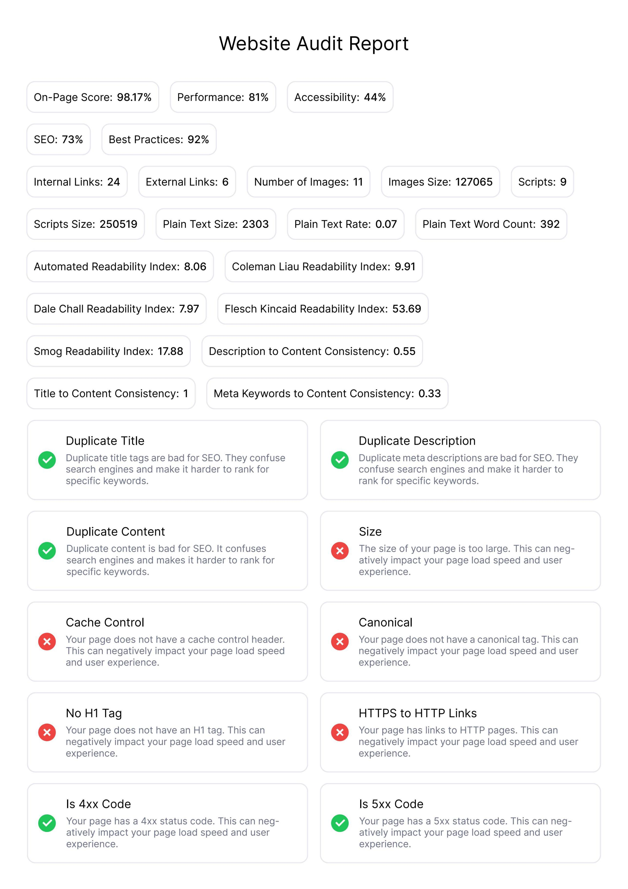
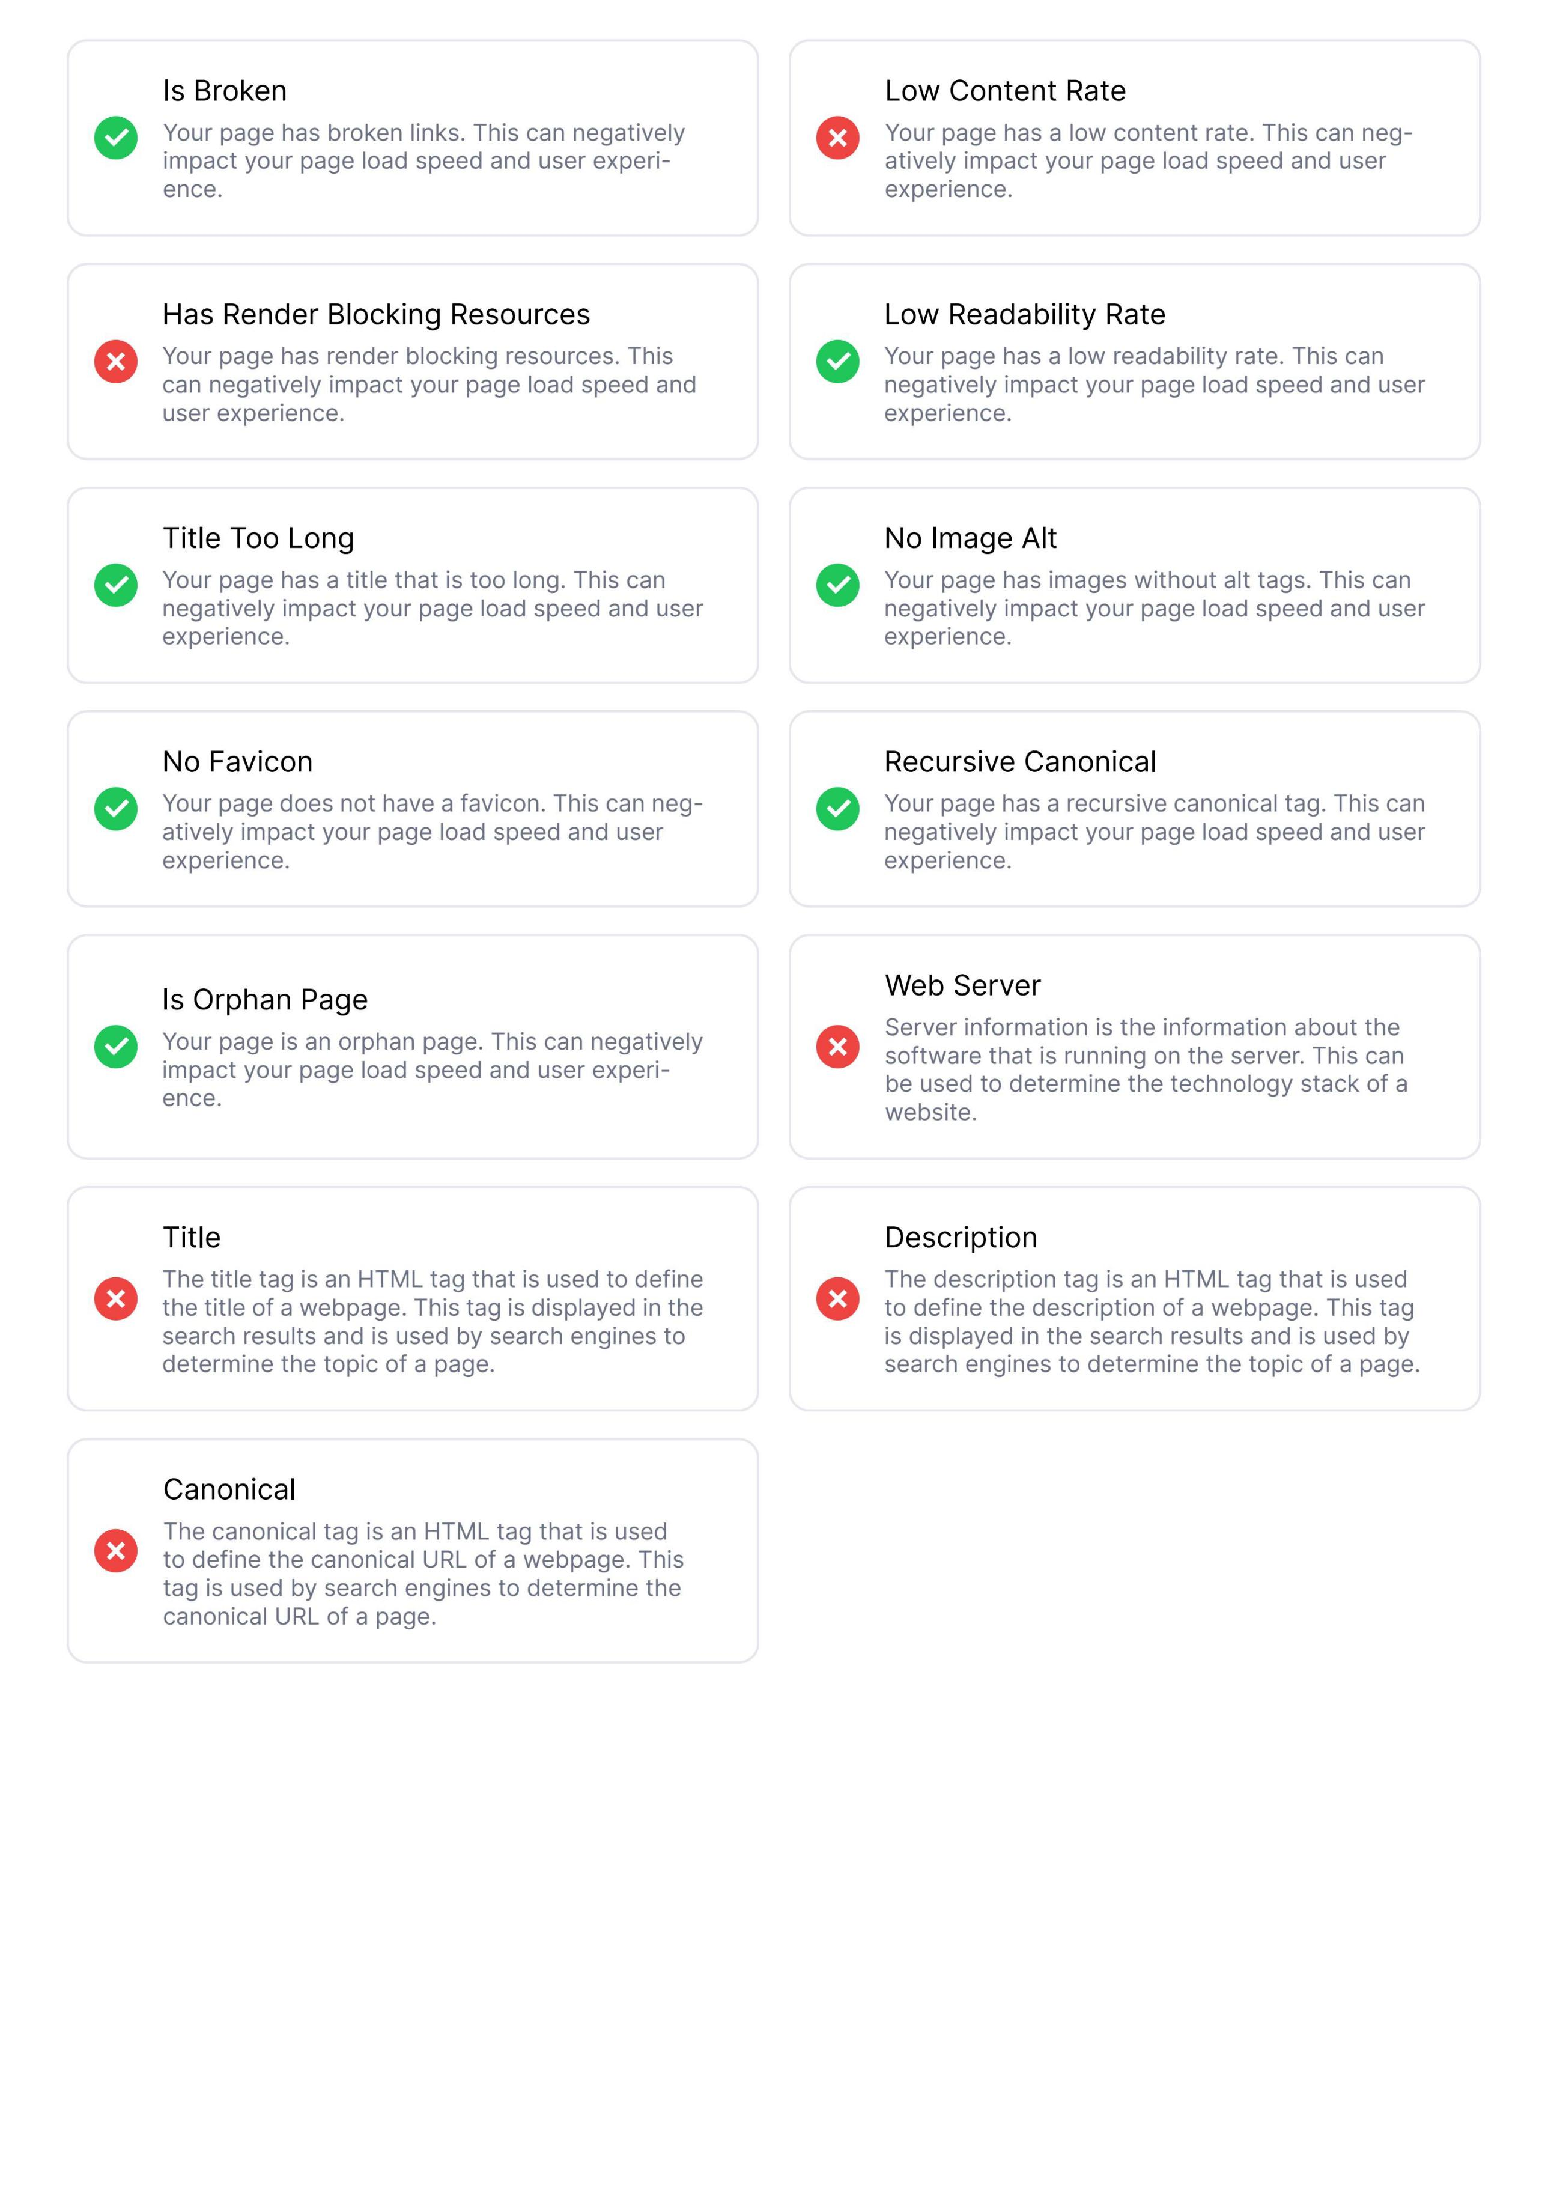
SEO AUDIT REPORT
Notes:
Links:
https://www.pexels.com/photo/group-of-people-watching-on-laptop-1595385/
https://www.pexels.com/photo/man-wearing-white-long-sleeved-shirt-holding-black-pen-3182781/
https://www.pexels.com/photo/group-of-people-in-conference-room-1181304/

Slide 19
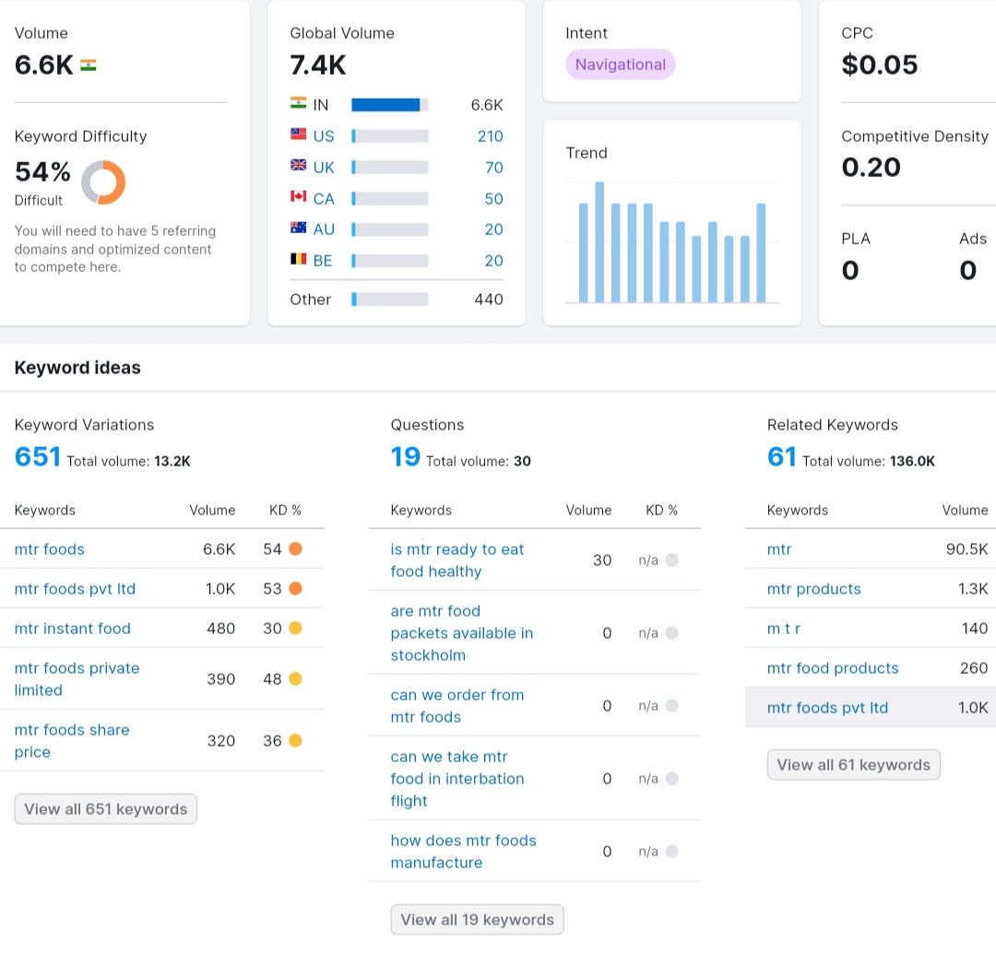
Keyword Research

Slide 20
CONCLUSION
MTR is one of the most prominent brands which manufacture instant foods under the ownership of Orkla. Apart from it the restaurant business is also present till date. The products make difference among the public due to the quality and price affordability. The above marketing strategies are the most important pillars upon which the company is standing.
The customer base for all the products made by MTR is decent because the items belong to their staple diet. Remarkably, the places where these products are exported mainly have prominent South Indian Communities. One of the main reasons why the company is gaining more importance in the recent years is due to more people gaining interest in South Indian Foods. Quick breakfast techniques are one of the main conveniences for any consumer who does not get much time for making it.

Slide 21
THANK YOU
Notes:
Image Sources:
https://www.pexels.com/photo/five-bulb-lights-1036936/

